Slide 1
The Story of Solution with Intelligent Cloud-BigData-IoT Tro!
Once upon a time…

Slide 2


Slide 3
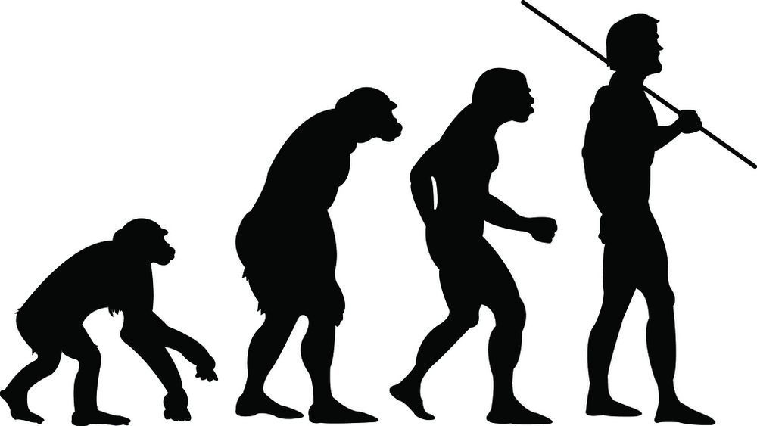
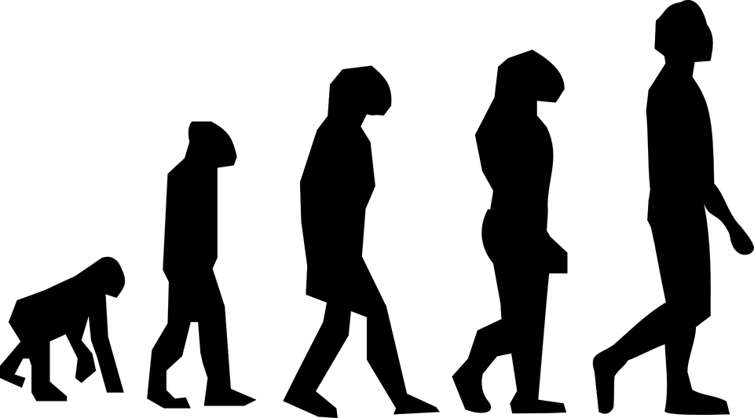
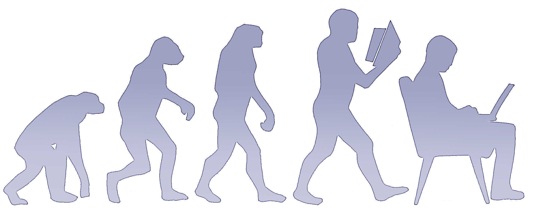
We, human continue to evolve…!
....to a rectangle…!

Slide 4
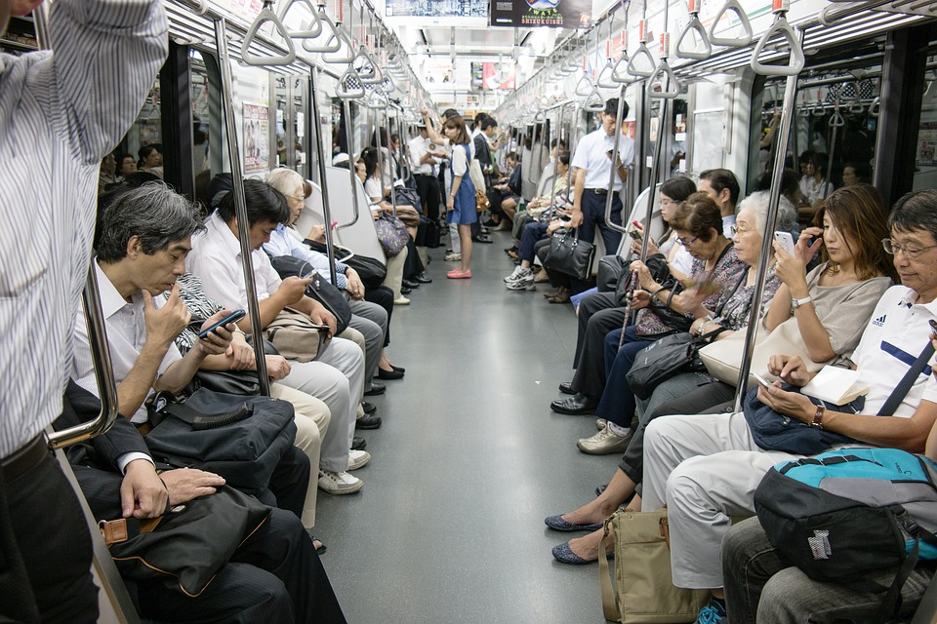
Actually to a smaller rectangle…!

Slide 5
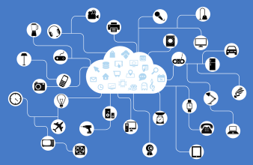
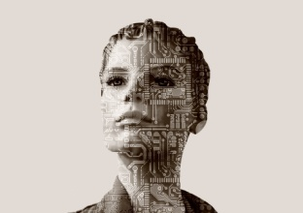
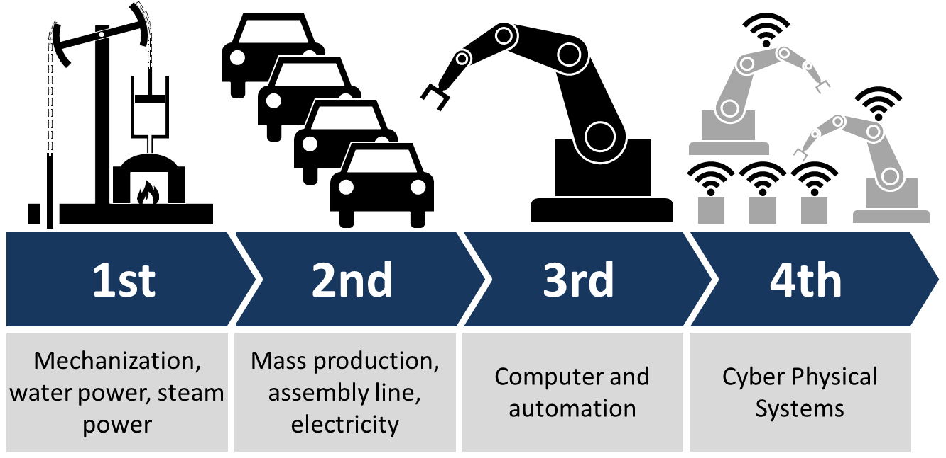
18th to 19th centuries Europe and America
1870 and 1914
just before World War I
1980s
Digital Revolution
Robotics, AI, Nano Technology, Quantum Computing, IoT…..
4th Industry Revolution(4IR) here!
“Information is the Oil and Analytics is the Combustion Engine!” - Gartner

Slide 6
Screenplay today…
Revisit the intro of Cloud, BigData, IoT and AI
See some interesting day to day use cases
Unlimited possibilities of solutions
Illustrate a complete solution from scratch
What happens behind the scene
Discuss the possibilities (not all! ;)
Going Ahead…possible twists in the story!

Slide 7
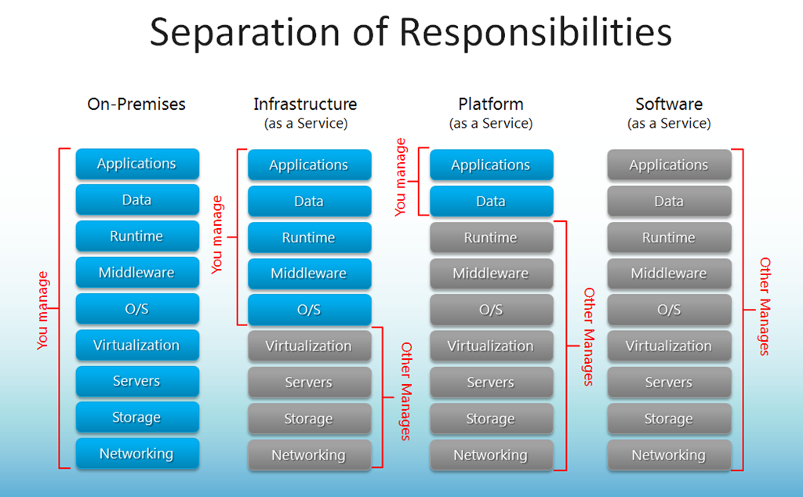
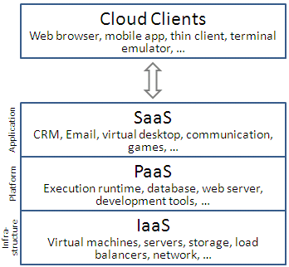
Cloud…
Cloud computing is a type of Internet-based computing that provides shared computer processing resources and data to computers and other devices on demand. It is a model for enabling ubiquitous, on-demand access to a shared pool of configurable computing resources (e.g., computer networks, servers, storage, applications and services) [from wiki]

Slide 8
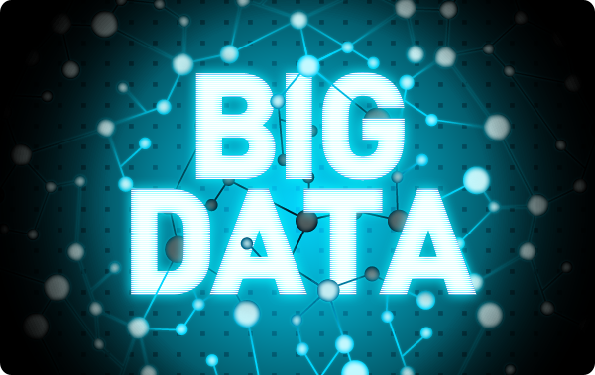
BigData…
Big data is a term for data sets that are so large or complex that traditional data processing application software is inadequate to deal with them. Big data challenges include capturing data, data storage, data analysis, search, sharing, transfer, visualization, querying, updating and information privacy. [from wiki]
Also tends to refer to the use of predictive analytics, user behavior analytics, or certain other advanced data analytics methods that extract value from data, and seldom to a particular size of data set.
1999, the term Big Data appeared in Visually Exploring Gigabyte Datasets in Real Time, published by the Association for Computing Machinery
90% of the world’s data was created in the last 2 years.

Slide 9

Volume
Low Massive
Velocity
Slow Accelerated
Veracity
High Uncertain Data
Variety
Less All Kind
Value
High Low per Volume
Verification
Not Critical Very Critical
Visualization
Simple, Easy Complex, Access

Slide 10
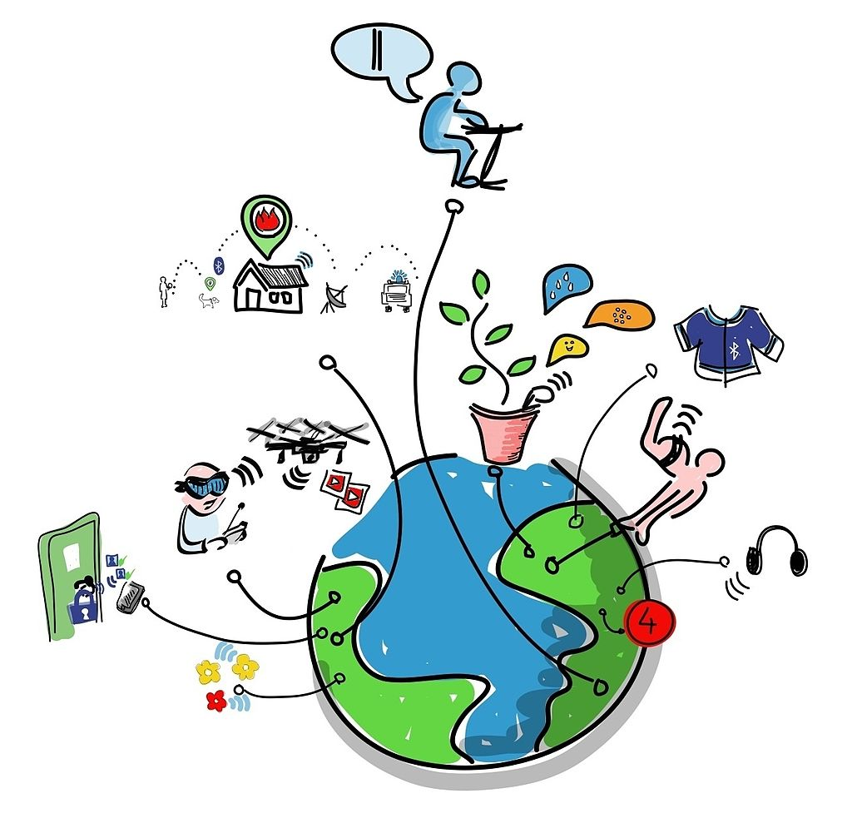
IoT…
The Internet of things (IoT) is the network of physical devices, vehicles, and other items embedded with electronics, software, sensors, actuators, and network connectivity which enable these objects to collect and exchange data. Each thing is uniquely identifiable through its embedded computing system but is able to interoperate within the existing Internet infrastructure [from wiki]

Slide 11
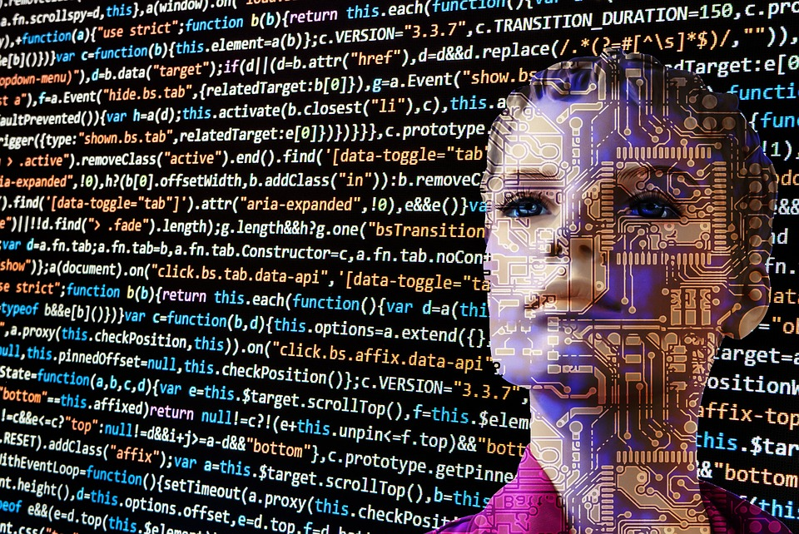
Artificial Intelligence…
Artificial intelligence (AI, also machine intelligence, MI) is apparently intelligent behaviour by machines, rather than the natural intelligence (NI) of humans and other animals. The term "artificial intelligence" is applied when a machine mimics "cognitive" functions that humans associate with other human minds, such as "learning" and "problem solving". [from wiki]

Slide 12
Health Care for HIV Patients are critical…!
Let’s try to build a solution together…

Slide 13
Usecase…
A home with HIV Infected Kids
The medicine on time in correct dosage is critical
Automate the tablet administration to the kids

Slide 14
…what we need, minimum?
Device for Dispensing the tablets
Central Infrastructure
Attributes:
Which+Dosage
Patient Identity
Timing
Alert
Some Security?
?
Attributes:
Processing
Data Storage
Reporting
Alert
Security
Reliability
Scaling
?

Slide 15
…add more perspectives…
Device for Dispensing the tablets
Central Infrastructure
Internet / Intranet
( Public / Private )
IoT Device
IoT Stack
Cloud Computing (PaaS, IaaS)
Big Data
AI / ML

Slide 16

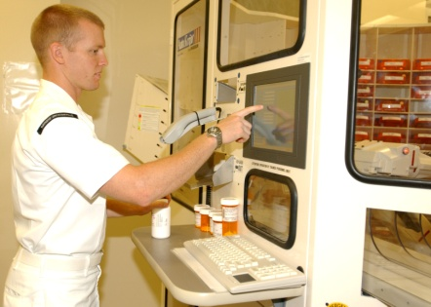
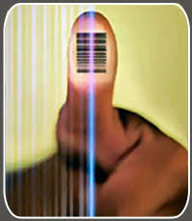
…technologies connected; a solution is getting ready…
Thing
Edge Cloud/Provider Cloud
Enterprise /Backend Cloud
App
n/w
n/w
Edge Services & IoT Gateway
User Directory and Data Store
Enterprise Application
Identification & Actuation
PaaS Container Kubernetes orchestration - Application comes up with DB service enabled – Authenticated
Medical Records processed
Action / Alerts initiated
Alerts sent (SMS/Mails)
DB, Enterprise App Services
Medial Report Fed, Doctor Recommendation Added
Analysis of Data
Actionable Intelligence
Scans Identity and provide data to edge
Action data received
Actions/Alert trigger received
Dispense Medicine
Blood Sample taken, safely locked or given
Alerts triggered
Data (json file)

Slide 17
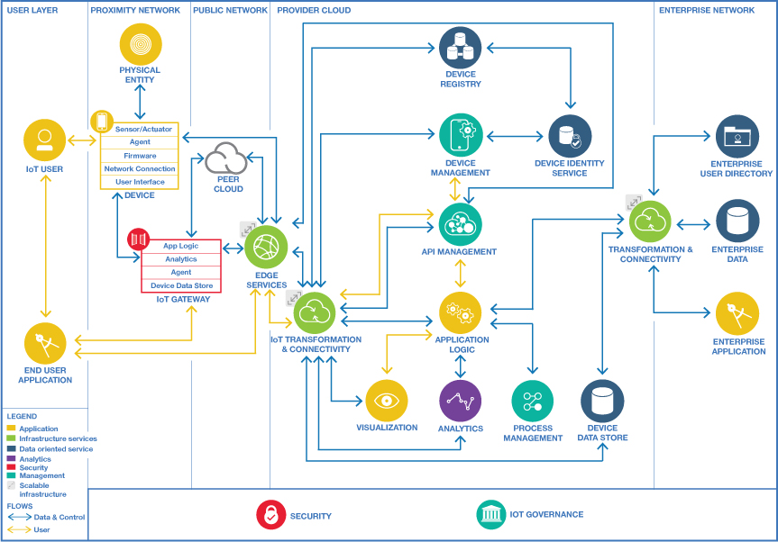
Cloud Components for IoT

Slide 18
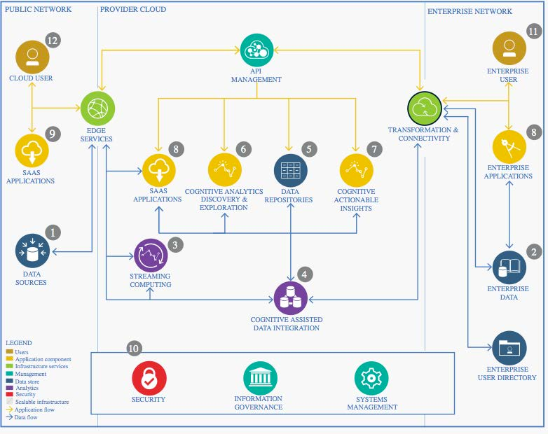
Cloud Components for Infrastructure/Compute, BigData, AI

Slide 19
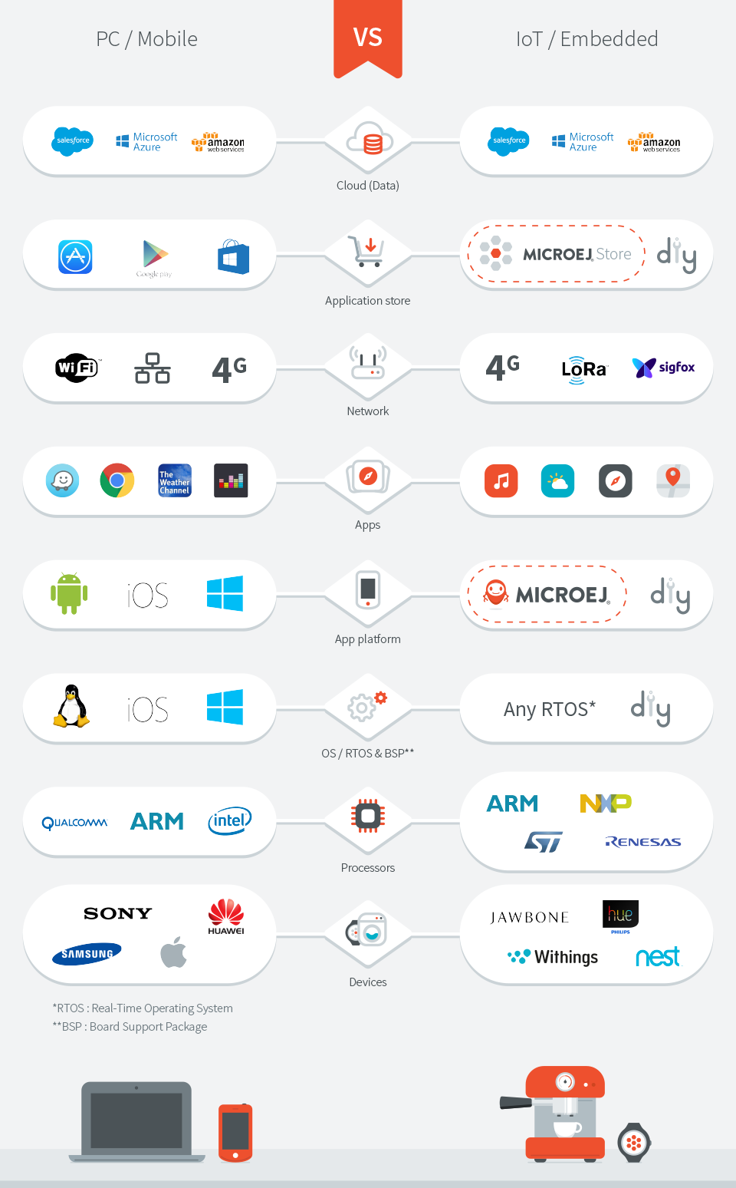

Slide 20
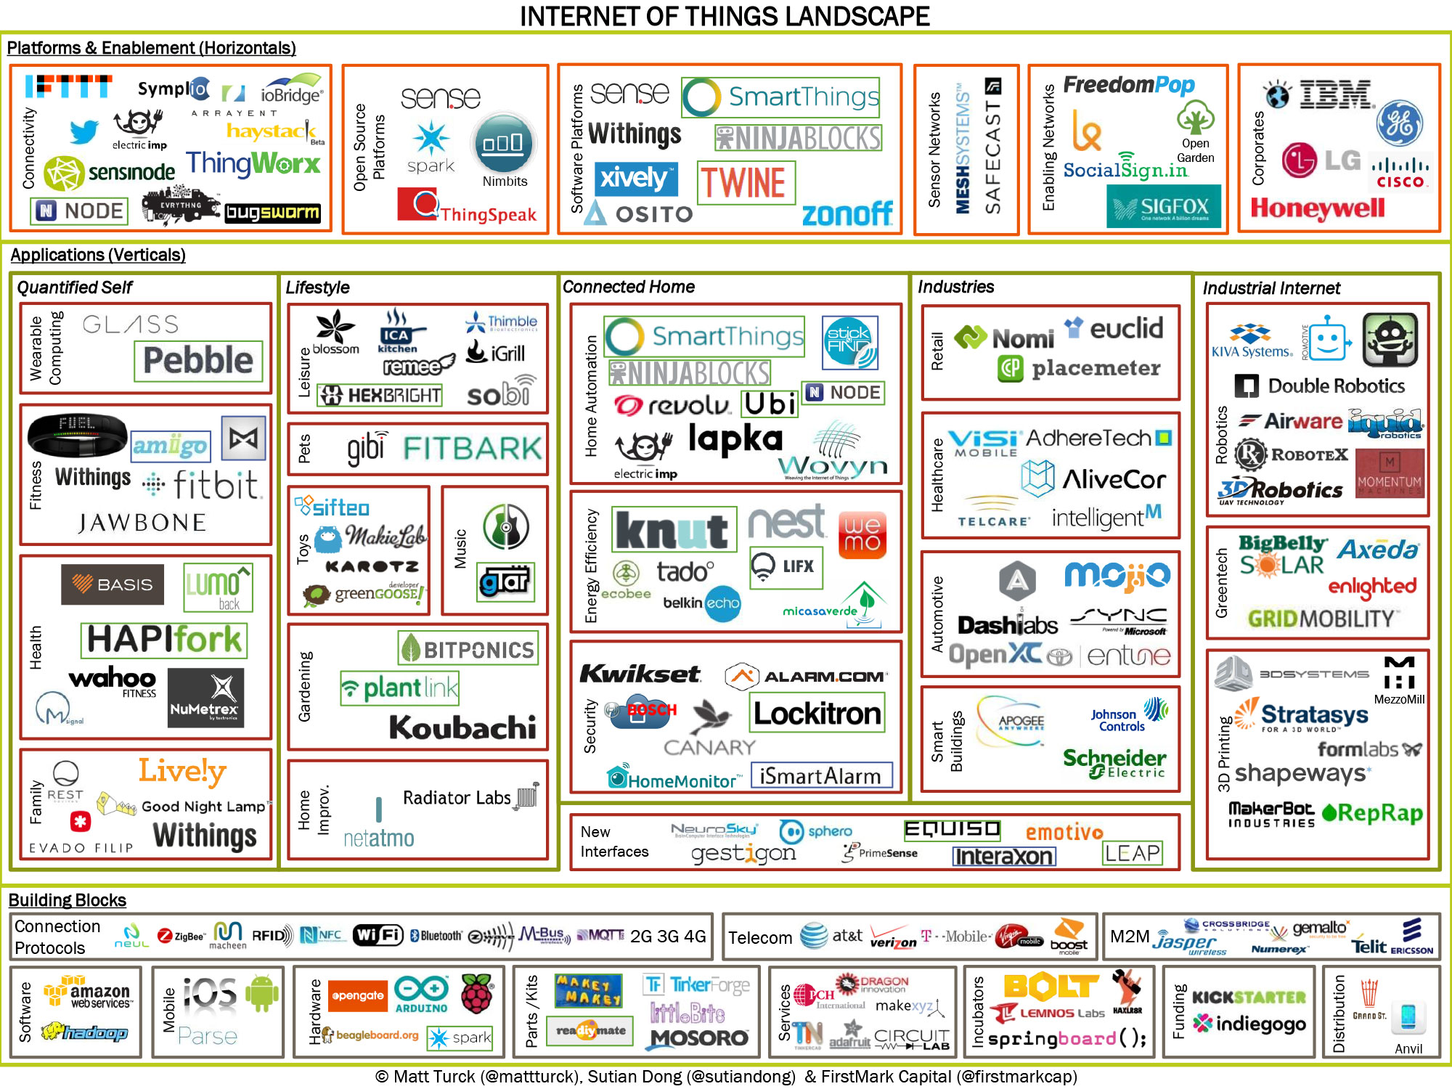
Notes:
https://www.google.co.in/search?q=cloud+map&biw=1920&bih=1025&source=lnms&tbm=isch&sa=X&ved=0ahUKEwjZhMDYv_PQAhVCs48KHYQwDfgQ_AUIBigB#tbm=isch&q=cloud+computing+landscape&imgrc=CyUVeqBFFsep3M%3A

Slide 21
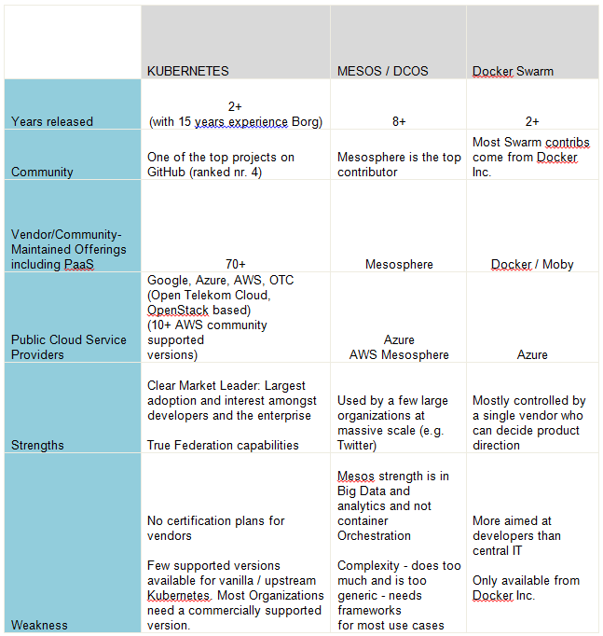
Cloud Computing Platform

Slide 22
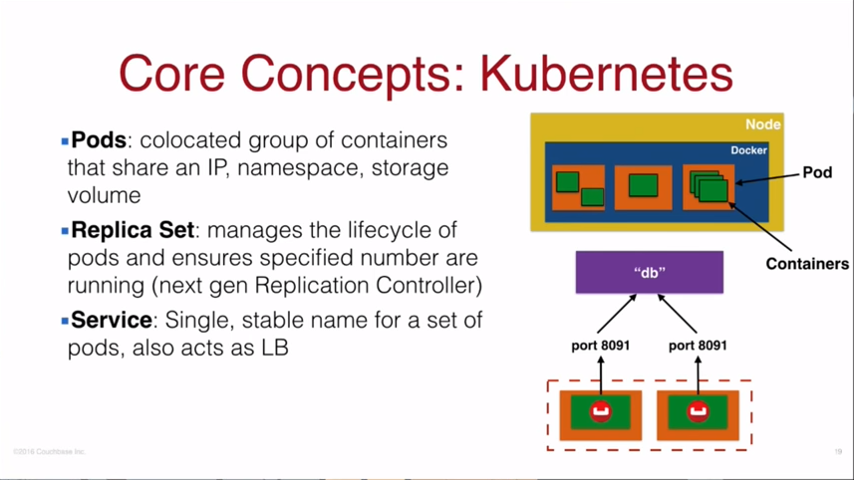
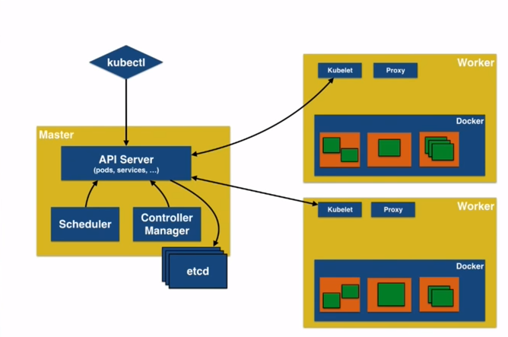
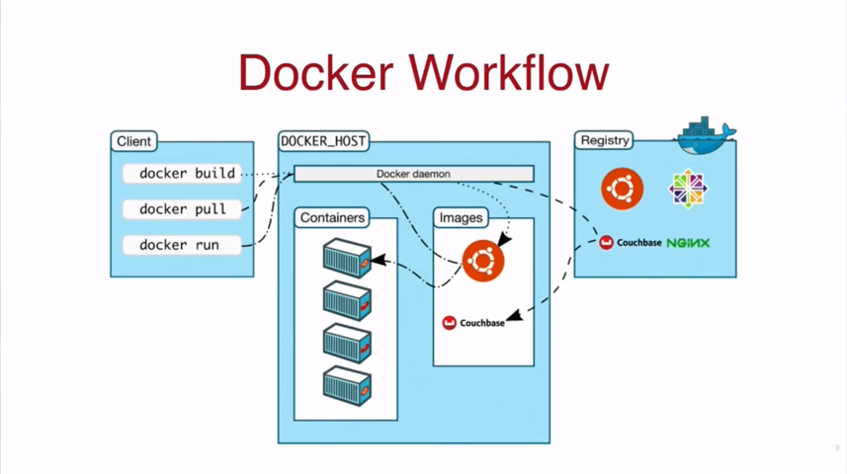

Slide 23
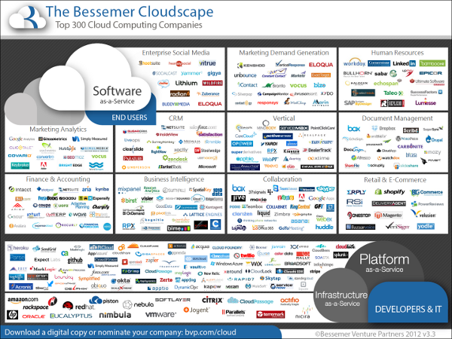
Notes:
https://www.google.co.in/search?q=cloud+map&biw=1920&bih=1025&source=lnms&tbm=isch&sa=X&ved=0ahUKEwjZhMDYv_PQAhVCs48KHYQwDfgQ_AUIBigB#tbm=isch&q=cloud+computing+landscape&imgrc=tr1q3iisuZxMUM%3A

Slide 24
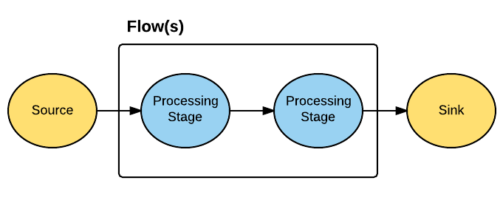







BigData
Store
Ingestion
Process

Slide 25
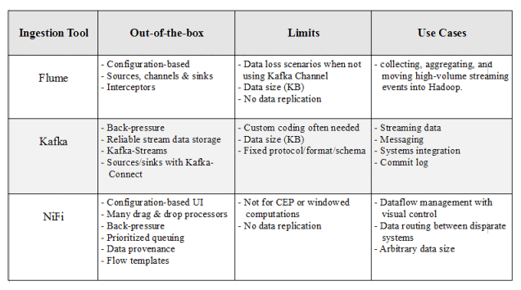

Slide 26
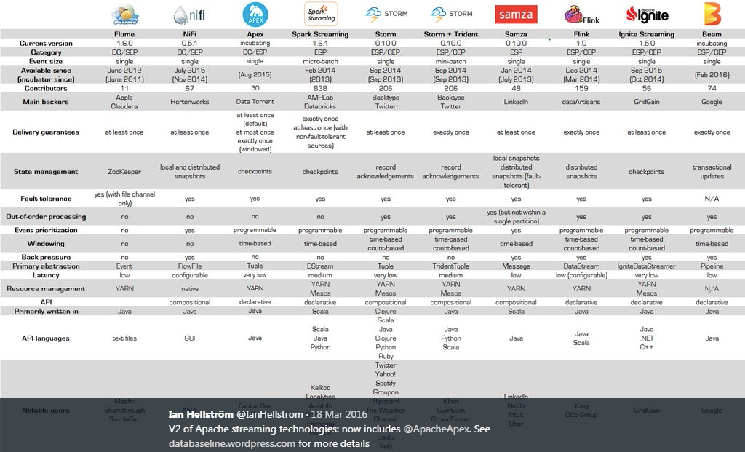

Slide 27
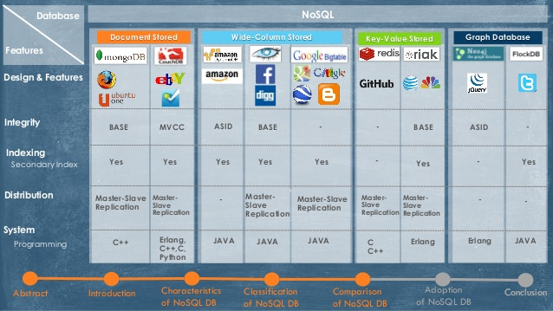

Slide 28
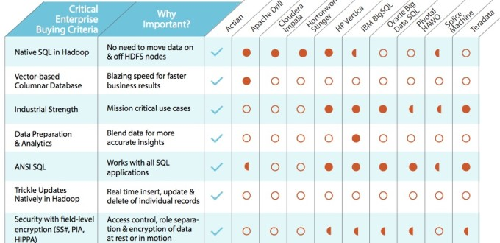

Slide 29
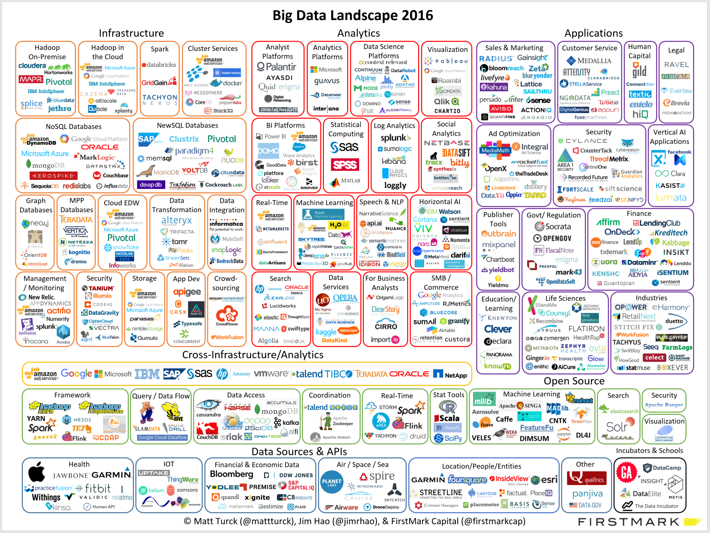
Notes:
https://www.google.co.in/search?q=cloud+map&biw=1920&bih=1025&source=lnms&tbm=isch&sa=X&ved=0ahUKEwjZhMDYv_PQAhVCs48KHYQwDfgQ_AUIBigB#tbm=isch&q=cloud+computing+landscape&imgrc=QXJgjzgaBmce

Slide 30
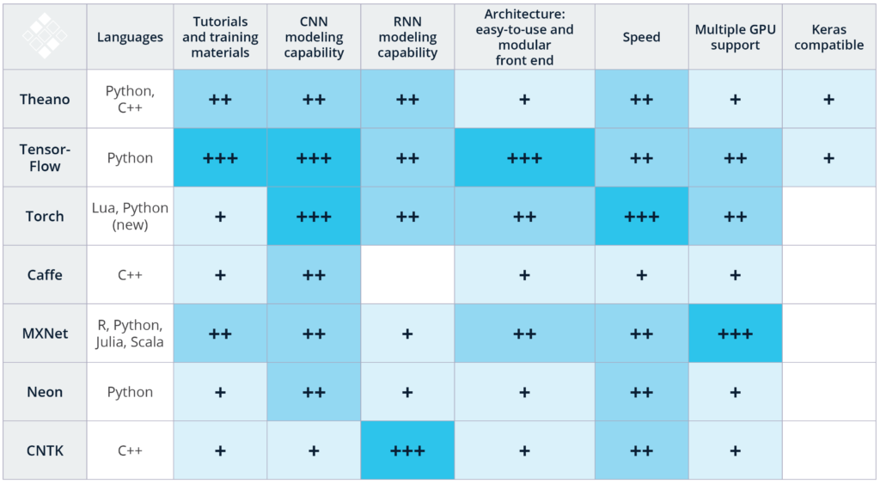
AI / ML

Slide 31
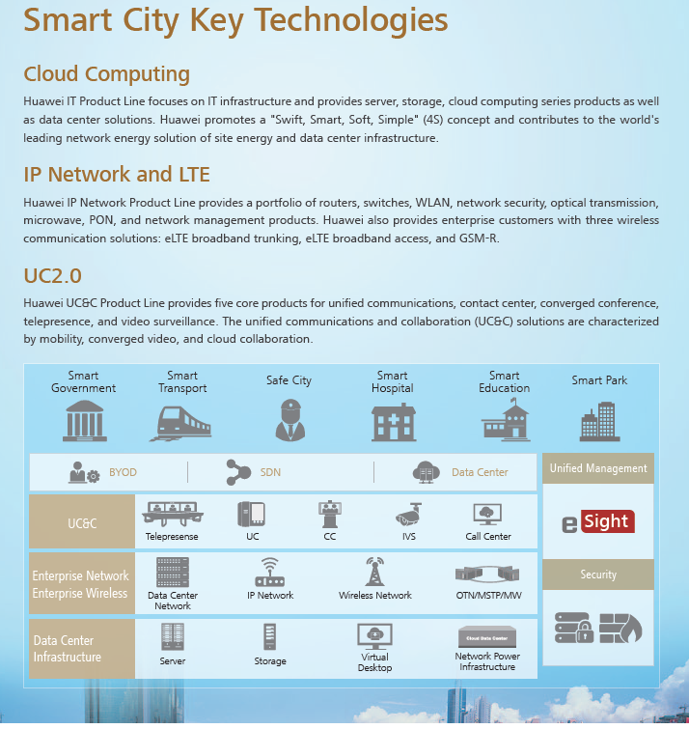
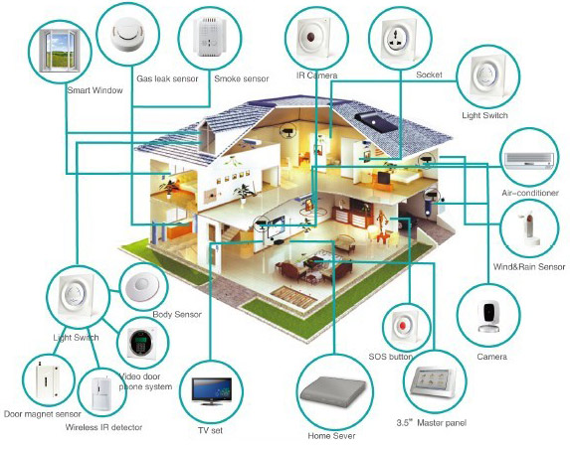
Technologies connected together…

Slide 32
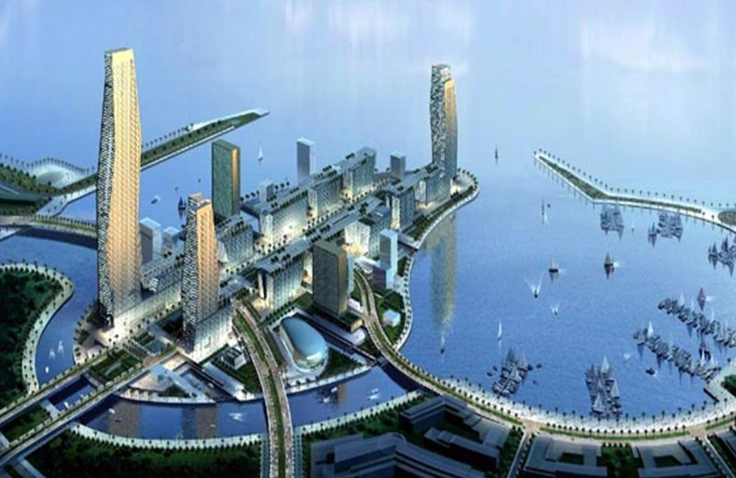
…already citites getting smarter…! Top Smart Cities
The smart city industry is projected to be a $400 billion market by 2020, with 600 cities worldwide.
These cities are expected to generate 60% of the world’s GDP by 2025, according to McKinsey research. https://dzone.com/articles/top-smart-city-projects-to-watch-in-2017
The following are the major use cases:
Waste Management
Security
Digital Kiosks
Smart Streetlights
Parking Sensors
Open Data Initiatives
Air Quality Sensor
Climate Monitoring
Social Impact
The Smartest Cities In The World For 2017
By IESE Cities in Motion Index 2017 https://www.forbes.com/sites/iese/2017/05/31/the-smartest-cities-in-the-world-for-2017/#2ca2c2b55c4c
European and North American cities dominate the list, accounting for 43 of the top 50 cities.
In Africa, Cape Town (133rd) remains the highest ranked city.
Buenos Aires (83rd) tops the Latin American ranking.
Abu Dhabi (64th) replaces Dubai (66th) as leader in the Middle East.
In Asia, the top three cities (Seoul, Tokyo and Singapore)
New York
London
Paris
Boston
San Francisco
Washington
Seoul
Tokyo
Berlin
Amsterdam
Top 10 Predictions for Smart Cities
The IDC FutureScape: Worldwide Smart Cities 2017 Predictions provides:
Prediction 1: By 2019, Countries with 50% of Their Midsize to Large Cities in the Repeatable Stage or Higher of Smart City Maturity Will Be More Successful in Country Digitization Efforts
Prediction 2: By 2017, 75% of Cities Worldwide Will Fail to Take Full Advantage of Smart City Data and Digital Assets Due to a Lack of Process, Project Management, and Change Management Skills
Prediction 3: In 2018, Cities Will Spend 2x More with Partners That Are Committed to Open APIs, Sharing Data, and Long-Term Relationships as Demonstrated via a Sales Force That Can Talk Business Outcomes
Prediction 4: By 2019, 50% of Open Data Initiatives Will Evolve to Provide Both Free and Monetized Data Services as Cities Test Data Revenue Models and Seek to Justify Open Data Investments
Prediction 5: City IT Systems Are Attractive Cybertargets, and in 2017, at Least One Midsize to Large City Will Suffer a Cyberattack That Will Impact Its Ability to Effectively Function for One Day
Prediction 6: By 2018, 20% of Public Safety Agencies Will Test Cognitive Computing to Predict and Prevent Domestic, Mental Health, and Addiction Incidents, Drastically Reducing Service Requests
Prediction 7: By 2019, 30% of Urban Consumers Will Use Bots or Intelligent Assistants for Multimodal Route Planning to Manage Cost, Carbon Impact, and Other Travel Preferences
Prediction 8: In 2017, 20% of Cities Will Nudge Transit Behavior by Limiting Parking, Promoting EV and Car Sharing, and Investing in Mobile Payments, Navigation, and Violations Tracking Apps
Prediction 9: With 180 Million Global LED Street Light Conversions by 2019 and Spending of $80 Billion, Light Infrastructure Will Become the Key Smart City Platform for Connected IoT Devices
Prediction 10: By 2019, to Scale and Survive, One-Third of Civic Engagement App Companies Will Merge with or Be Acquired by Larger Companies as Part of a Smart City Platform Offering

Slide 33
…more technologies to the list…
Blockchain (You might have heard bit coins…and invested? ;)
AR/VR
New perspectives to Deep Learning – Immersive Experience, Neuromorphic Computing
Quantum Computing
5G
Industrial IoT, Autonomous Vehicles
GPU, AI Chipsets
3D Printing…

Slide 34
…going ahead: Anticipate the unanticipated!

Slide 36

The Story Continues…
…they live happily ever after…???
Thank You! Krishna Kumar & Sanil Kumar
Disclaimer: Images & many data are taken from Internet and only used for information sharing. We do not claim any other rights/correctness to it. Also no commercial usage of these slides allowed.

